Slide 1

USACO Bronze Week 4 and 5

Slide 2

Content of today’s class
Warm-up: PythonChallenge - fun puzzles you can implement in C++/Java :)
ArrayList/Vectors
Simulation Problems
Optional (if you want):
Stack
Queue
Simulation Problems (continued?)

Slide 3
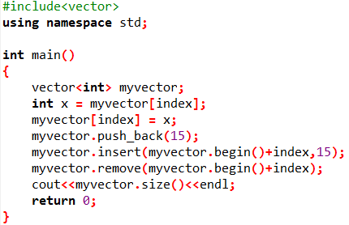
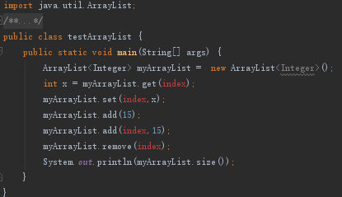
Array(ArrayList/Vector)
ArrayList(Java)/Vector(C++) ArrayLists/Vectors are an expandable array that has no fixed size.

Slide 4
Array(ArrayList/Vector)
Syntax:
C++:
vector<object> vector_name;
Java: ArrayList<Object> alist = new ArrayList<Object>();
Operation (Java) | Equivalent Operation in C++ | Complexity/Runtime
arr.get(index) | vec[index] | O(1) (Constant)
arr.add(element) | vec.push_back(element) | O(1)
arr.add(index, element) | vec.insert(element, index) | O(N) (Linear)
arr.remove(index) | vec.erase(index) | O(N)
arr.size() | vec.size() | O(1)
arr.set(index, element) | vec[index] = element | O(1)

Slide 5
Array(ArrayList/Vector)
Write a program to implement an ArrayList/Vector(ArrayList), and follow the steps below:
1. Add 1 to 10 to your Vector(ArrayList) in order.
2. Remove the 6th element inside of the Vector(ArrayList).
3. Change the 5th element to 15.
4. Output all the elements inside of the Vector(ArrayList).

Slide 6
Array(ArrayList/Vector)
Java:
ArrayList<Integer> arr = new ArrayList<Integer>();
for(int i = 1; i <= 10; i++) {
arr.add(i); //1 to 10
}
//sixth element = index 5! REMEMBER - this is O(N)
arr.remove(5);
arr.set(4,15);
for(int i = 0; i < 10; i++) //for (int element : arraylist) {
System.out.println(arr.get(i)); //don’t use bracket notation }

Slide 7
Array(ArrayList/Vector)
C++:
vector<int> vec;
for(int i = 1; i <= 10; i++) {
vec.push_back(i); //1 to 10
}
//sixth element = index 5! REMEMBER - this is O(N)
vec.erase(vec.begin()+5);
vec[4] = 15; //in C++, bracket indexing OK :-)
for(int i = 0; i < 10; i++) {
cout << vec[i] << ‘\n’; }

Slide 8
1D Problems
Many USACO problems are “simulation”-type, and you will need to use multiple for-loops/arrays to keep track of movements.

Slide 9
1-D Problems
Farmer John has lost his prize cow Bessie, and he needs to find her!
Fortunately, there is only one long path running across the farm, and Farmer John knows that Bessie has to be at some location on this path. If we think of the path as a number line, then Farmer John is currently at position x and Bessie is currently at position y (unknown to Farmer John). If Farmer John only knew where Bessie was located, he could walk directly to her, traveling a distance of |x−y|. Unfortunately, it is dark outside and Farmer John can't see anything. The only way he can find Bessie is to walk back and forth until he eventually reaches her position.
http://www.usaco.org/index.php?page=viewproblem2&cpid=735

Slide 10
1-D Problems
Keep track of lots of variables:
Direction (are we going a higher (+) or lower (-) position)?
Destination (where are we going towards)?
Current Position (where are we?)
Distance Traveled (how far are we)?
Some factor (to help us with direction/ +1,-2,+4)
Link to code (please try the problem before you open!): https://repl.it/repls/WonderfulDeficientDeals

Slide 11
Another Simulation (Why Did the Cow Cross Road III)
Farmer John, in his old age, has unfortunately become increasingly grumpy and paranoid. Forgetting the extent to which bovine diversity helped his farm truly flourish over the years, he has recently decided to build a huge fence around the farm, discouraging cows from neighboring farms from visiting, and completely prohibiting entry from a handful of neighboring farms. The cows are quite upset by this state of affairs, not only since they can no longer visit with their friends, but since it has caused them to cancel participation in the International Milking Olympiad, an event to which they look forward all year. Neighboring cows that still have the ability to enter Farmer John's property find the process has become more arduous, as they can enter only through a single gate where each cow is subject to intense questioning, often causing the cows to queue up in a long line.
http://www.usaco.org/index.php?page=viewproblem2&cpid=713
https://www.w3schools.com/java/ref_string_compareto.asp - About compareTo functions
https://repl.it/repls/LightpinkSkeletalOptimization

Slide 12
Simulation w/ Repeated Process
Farming is a competitive business -- particularly milk production. Farmer John figures that if he doesn't innovate in his milk production methods, his dairy business could get creamed! Fortunately, Farmer John has a good idea. His three prize dairy cows Bessie, Elsie, and Mildred each produce milk with a slightly different taste, and he plans to mix these together to get the perfect blend of flavors. To mix the three different milks, he takes three buckets containing milk from the three cows. The buckets may have different sizes, and may not be completely full. He then pours bucket 1 into bucket 2, then bucket 2 into bucket 3, then bucket 3 into bucket 1, then bucket 1 into bucket 2, and so on in a cyclic fashion, for a total of 100 pour operations (so the 100th pour would be from bucket 1 into bucket 2). When Farmer John pours from bucket a a into bucket b, he pours as much milk as possible until either bucket a a becomes empty or bucket b b becomes full. Please tell Farmer John how much milk will be in each bucket after he finishes all 100 pours.
http://www.usaco.org/index.php?page=viewproblem2&cpid=855

Slide 13
1-D Problems
Bessie the cow has designed what she thinks will be the next big hit video game: "Angry Cows". The premise, which she believes is completely original, is that the player shoots a cow with a slingshot into a one-dimensional scene consisting of a set of hay bales located at various points on a number line; the cow lands on a hay bale with sufficient force to cause the bale to explode, which in turn might set of a chain reaction that causes additional nearby hay bales to explode. The goal is to use a single cow to start a chain reaction that detonates as many hay bales as possible.
This may be difficult to implement. Let me know if you have any questions!!!
http://www.usaco.org/index.php?page=viewproblem2&cpid=592

Slide 14
How to solve?
2 ways:
Brute force. Since N ≤ 100 and we are doing Bronze-level problems, this is definitely possible!
Sorting and simulating. I’ll show this method - what if N ≤ 10^5? Brute force won’t work here

Slide 15
Homework (10/5)
Work on these:
The Lost Cow
Why Did the Cow Cross the Road (III)
Mixing Milk
Optional - Angry Cows
Optional topics - Queues/Stacks:
“Reverse” polish notation
Bracket sequences

Slide 16
Queues/Stacks (if we have time)
This stuff is OPTIONAL (Silver/Gold level stuff), we’ll do these if we have time.
If you’re interested in this stuff and we don’t cover it in class, just ask me :) I would be more than happy to help you on these stuff.

Slide 17




Stack & Queue
Stack (LIFO: Last In First Out):
Like a box of books. The last book you put inside will be the first one you can take out.
Most Commonly Used: Depth-First Search (Silver), Recursion (implicitly), etc.
Add(Push)
Remove(Pop)
Bottom Does Not Change

Slide 18
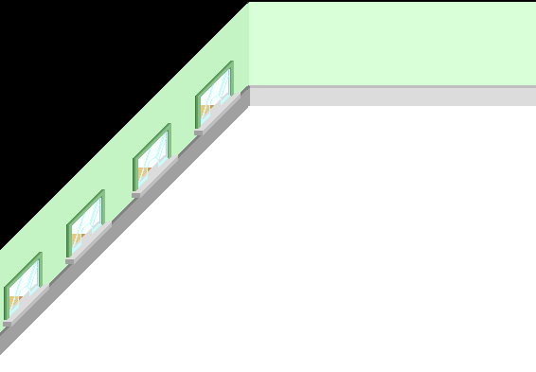

Stack & Queue
Queue (FIFO): First In First Out
It's like you are standing in line to buy movie tickets at the theater. The first person who comes to the window will be the first one to get his ticket and exit the line.
Most Commonly Used: Breadth-First Search (BFS- covered in Silver, etc.
1 2 3 4
2 3 4
3 4
4

Slide 19
Stack & Queue
Purpose | Java | C++
Declare stack, O(1) | Stack<Integer>stk = new Stack<Integer>(); | stack<int>stk;
Get top element, O(1) | int x = stk.peek(); | int x = stk.top();
Remove and return top, O(1) | int x = stk.pop(); | stk.pop();
Insert element at top, O(1) | stk.push(x); | stk.push(x);
Get size, O(1) | int sz = stk.size(); | int sz = stk.size();
Is stack empty?, O(1) | boolean empty = stk.empty(); | bool empty = stk.empty();

Slide 20
Stack & Queue (all O(1) operations)
Purpose | Java | C++
Declare Queue | Queue<Integer>q = new LinkedList<Integer>(); | queue<int> q;
Get top element | int x = q.peek(); | int x = q.front();
Remove and return top | int x = q.remove(); | q.pop();
Insert element at end | q.add(x); | q.push(x);
Get size | int sz = q.size(); | int sz = q.size();
Is queue empty? | boolean empty = q.isEmpty(); | bool empty = q.empty();

Slide 21
Stacks: “Parenthesis”
Exercise:
Given a string containing just the characters '(', ')', '{', '}', '[' and ']', if the input string is valid.
The brackets must close in the correct order, "()" and "()[]{}", and “{{[]}}([]) are all valid but "(]" and "([)]" are not.
Sample Input: (parentheses.in)
([)]
Sample Output: (parentheses.out)
false http://138.197.210.211/JudgeOnline/problem.php?id=1073

Slide 22
Stacks - “Polish Calculator”
Reverse Polish Notation
https://en.wikipedia.org/wiki/Reverse_Polish_notation
7 4 + 3 - → (7+4) - 3
1 2 * 3 4 * + → (1*2) + (3*4)
2 5 / 3 * → (⅖)*3
http://138.197.210.211/JudgeOnline/problem.php?id=1074

